Slide 1
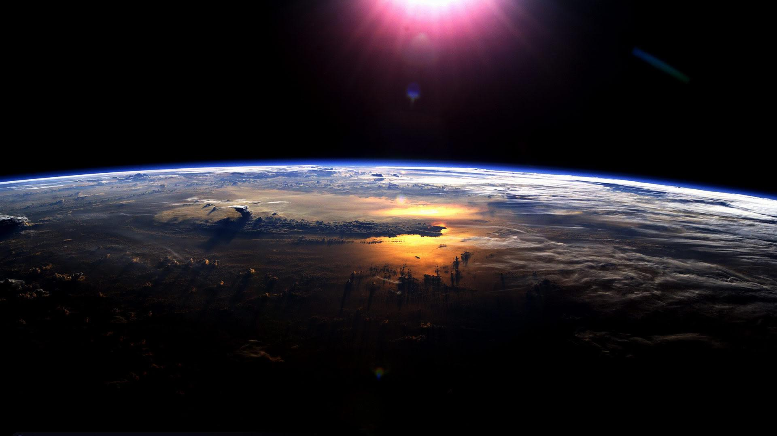
GLOBE Protocols

Slide 2
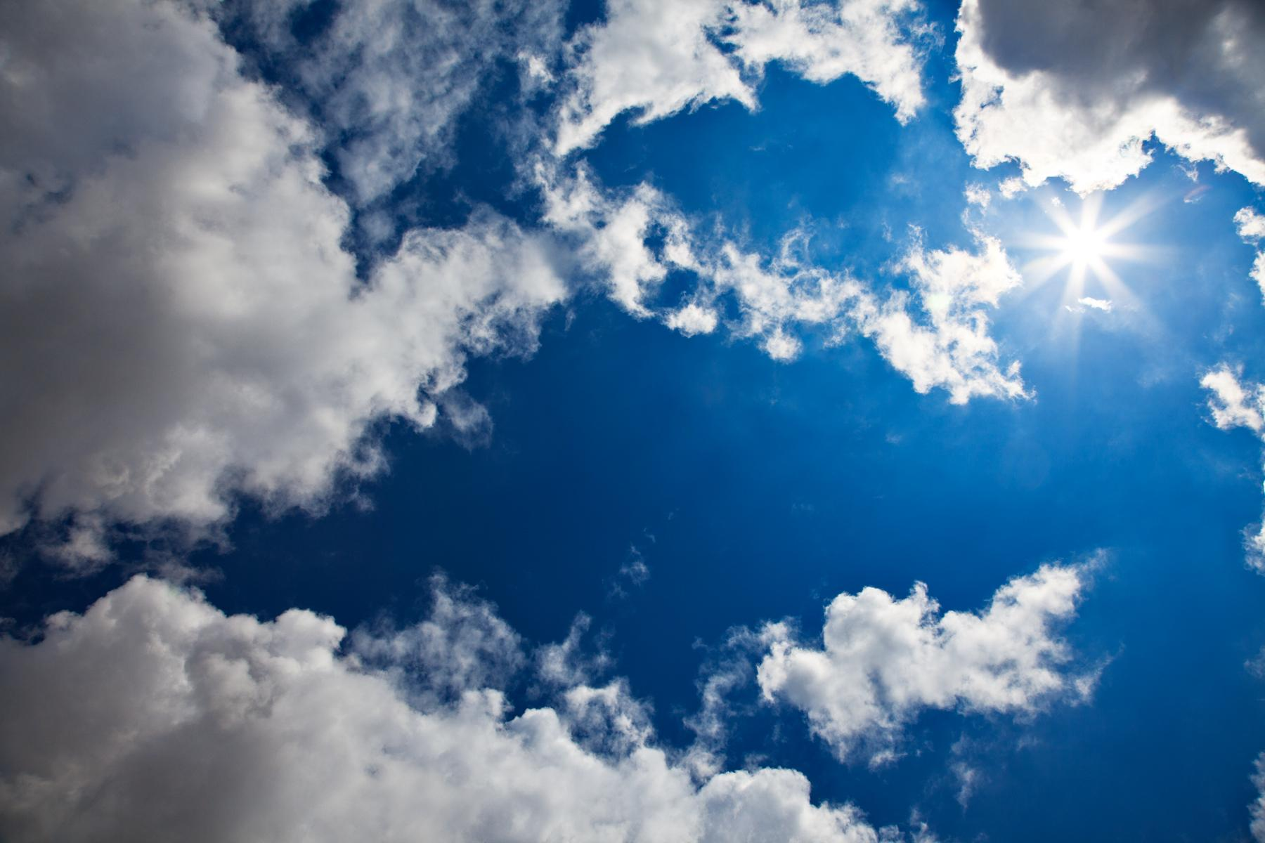
The fraction of the sky obscured by clouds when observed from a particular location
Steps:
1. Look in ALL directions of the sky for any clouds. *avoid sun*
2. Identify types of clouds using GLOBE cloud chart and Observing Cloud Type.
3. Check boxes on Atmosphere Investigation Sheet for every cloud you see.
4. Check for contrails
Three types:
Short-lived
Persistent non-spreading
Persistent spreading
5. On your Atmospheric Investigation Sheet, check off:
Cloud cover
Sky blockage
What you’ll need:
GLOBE cloud chart
Observing Cloud Type
Atmosphere Investigation Sheet

Slide 3
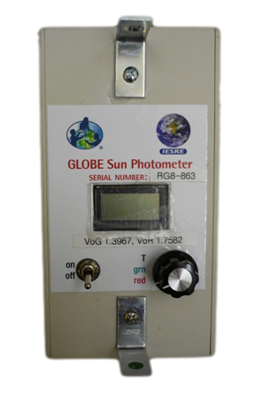
Aerosols
Definition: The optical thickness of the atmosphere (How much the sun’s light is scattered or absorbed by particles suspended in the air)
Steps:
Set the sunphotometer to “T” and multiply reading by 100 for temperature.
Set To RED wavelength and point towards the sun and line the shadow with the dot to record the RED wavelength
Then Cover the 2 holes on the top and take the DARK READING
Then repeat steps 2 and 3 and set sunphotometer to GREEN wavelength.
Then repeat steps 1-3 at least 2 more times (Max 5 times).
Then Record the temperature when you're done.
Finally turn the sunphotometer and place it back in it rightful place.

Slide 4
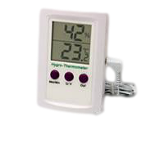
Humidity
the amount of moisture in the air.
How to work a hygrometer
-Press on/off button to turn on.
-Set meter in shelter at least 30 minutes before local solar noon begins.
-After 30 minutes, read relative humidity to the nearest 1% on the digital display.
*Make sure max/min indicators are not lit. If so, this means that the instrument is showing actual value.*
-Enter data on data sheet.
-Don’t forget to keep instrument
in a dry location.
-Max/Min: keeps memory of maximum and minimum readings
-Press once for max
-Press twice for minimum
-Press three times to return to normal display
-Hold button for 3 seconds to clear memory
-C/F: changes temperature units from C to F
Out: shortened for “outdoor”
-Press once to display zone 2
-Press twice to return to normal display

Slide 5
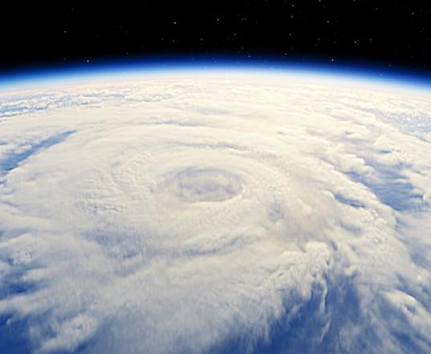
Ozone:2 2 types of ozone: The good ozone that protects us from UV radiation in the atmosphere, and the ozone near the ground which is harmful.
Calibration:
1.To calibrate the test strip place a new untouched strip in the scanner. Face it away from direct sunlight.
2.Turn off scanner and remove the unexposed strip
Procedure:
1.Clip the same ozone strip from the testing site 1 hour before solar noon
2.Slide the ozone strip into the slot on top of the scanner. The chemical part should be facing the display.
3.The display will stop fluctuating after 5-10 seconds. If the number is fluctuating between 2 numbers choose the lower number.
4.Record the number in parts per billion on the data sheet. Then turn the scanner off.
5.Place the strip into a sealed plastic bag and record the time of the reading.

Slide 6
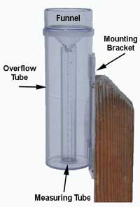
Precipitation
•Take the rain gauge off the pole, then record amount in the graduated cylinder from the top of the meniscus
•If there is rain in the overflow then pour it all including amount in smaller graduated cylinder into a larger graduated cylinder
•Record rain measurement to the tenth of a milliliter, if its less than .5 milliliters its T for trace, if rain has been accumulating in the gauge for more than one day make a note of it
•To record PH pour a single layer of salt onto a salt card which has 4 millimeter and 5 millimeter circles
•If 30-40 ml of water use 4mm circle if 40-50 ml use 5mm circle, any extra
amount of water over 30ml repeat process
•Pour salt into beaker with sample of water
•Then follow directions on salt card
•If more than one measurement of ph average the two

Slide 7
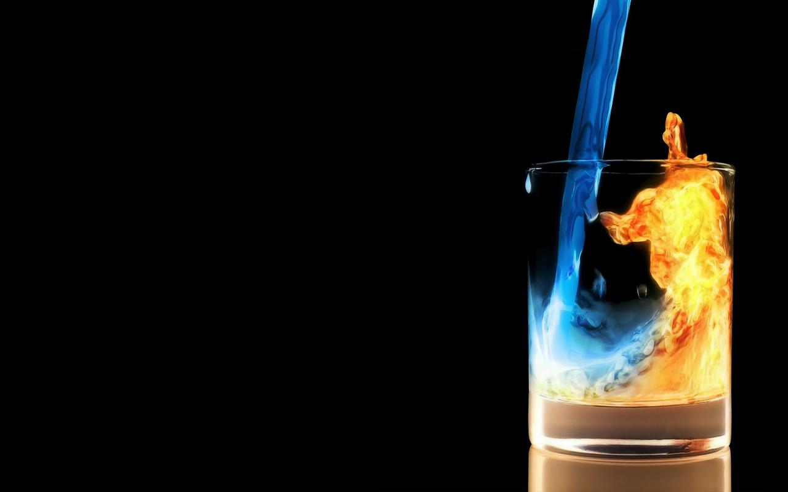
Temperature
To calibrate a thermometer: Place thermometer in beaker of ice water for 10-15 min, swirl occasionally.
After 10-15 minutes, the temperature should be 0ºC +/-0.5ºC
Record the correction factor on a piece of tape attached to the thermometer
To take the current air temperature reading and record the results.
Calculate the +/-0.5ºC calibration reading if necessary

Slide 8
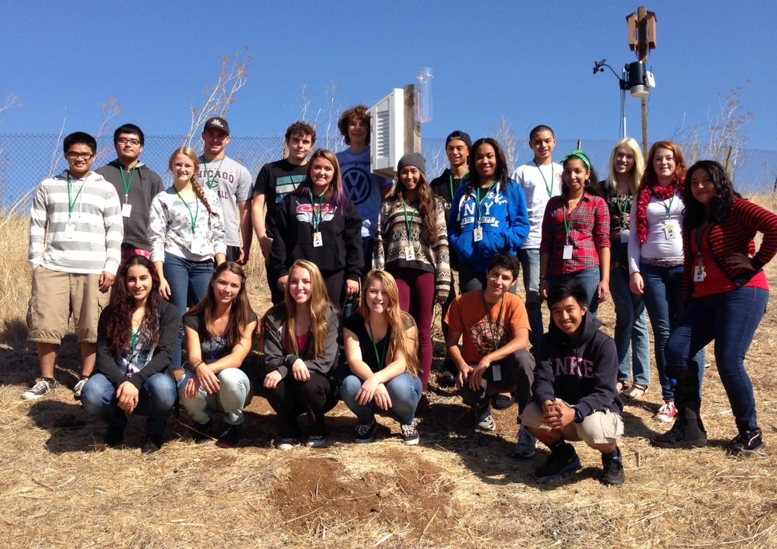
Presentation By
Keep our Earth classy, not trashy!

Slide 9
The End

